Slide 1

ISE 218: Fundamentals of Information Technology
Final Review: Units 7, 8, and 9
Spring 2025
Instructor: Abid Malik
co-Instructor: Xinrui Yu

Slide 2
Final Exam
06/29, 16:00 – 18:00, Hulian Building, CLOSED-BOOK, CLOSED-NOTES
Scope: Unit 07, 08, and 09
Bring your 2B pencils
41 multiple choice questions (select one single option)
First 25 questions (50 points) will be about concepts
Remaining 16 questions (50 points) will be calculations
Some equations and information will be available (see next slide)

Slide 3
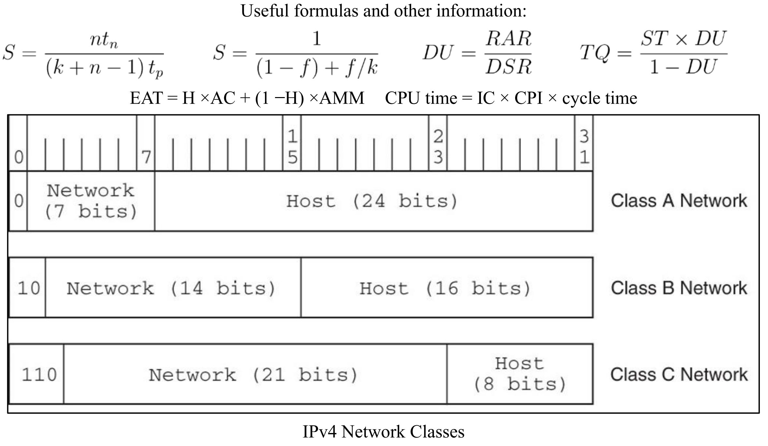

Slide 4
Unit 07 System Software
OS, Kernel, Process Scheduling and Programming Languages

Slide 5
A Quick History of Operating Systems
As more sophistication crept into resident monitors – starting/stopping jobs, handling I/O, switching between jobs – monitors evolved into more complex operating systems more like OSes of today
In the 1960s, hardware had become powerful enough to accommodate multiprogramming, the concurrent execution of more than one task.
Multiprogramming is achieved by allocating each process a given portion of CPU time (a time slice).
Interactive multiprogramming systems were called timesharing systems.
  Multiple, concurrent users connect to the computer via terminals
  When a process is taken from the CPU and replaced by another, we say that a context switch has occurred.
Notes:
多程序设计
分时系统
上下文（运行环境）切换
To avoid idleness

Slide 6
A Quick History of Operating Systems
Today, multiprocessor systems have become commonplace.
  They present an array of challenges to the operating system designer, including the manner in which the processors will be synchronized, and how to keep their activities from interfering with each other.
Tightly coupled multiprocessor systems share a common memory and the same set of I/O devices.
  Symmetric multiprocessor (SMP) systems are tightly coupled and load balanced. All processors work on a common task together.
Loosely coupled multiprocessor systems have physically separate memory.
  These are often called distributed systems.
  Another type of distributed system is a networked system, which consists of a collection of interconnected, collaborating workstations.

Slide 7

Operating System Design
Two operating system components are crucial: the kernel and the system programs.
As the core of the operating system, the kernel performs scheduling, synchronization, memory management, interrupt handling and also provides security and protection.
Microkernel systems provide minimal functionality, with most services carried out by external programs.
Monolithic systems provide most of their services
within a single operating system program.
Mono: single Lith: stone
Notes:
微内核系统
宏内核系统/

Slide 8
Operating System Design
Microkernel systems provide better security, easier maintenance, and portability at the expense of execution speed. (Examples: MINIX, Mach, QNX.)
  SMP computers are ideal platforms for microkernel operating systems because they consist of small services that can run independently
Monolithic systems give faster execution speed, but are difficult to port from one architecture to another. (Examples: Linux, MacOS, and DOS.)
Windows has a hybrid kernel with aspects of both microkernels and monolithic kernels
  The Windows OS consists of many modules that communicate with the main part of the kernel. This is basically how a microkernel operates.
  However, these modules share memory with the rest of the kernel, which is how a monolithic kernel is structured.
Notes:
微内核系统
宏内核系统/

Slide 9
Operating System Services
What are some of the responsibilities or tasks of an operating system that you are familiar with?
In other words, what are some basic tasks a computer can perform that are not necessarily associated with a single program or group of programs?

Slide 10
Operating System Services
Process management lies at the heart of operating system services.

Slide 11
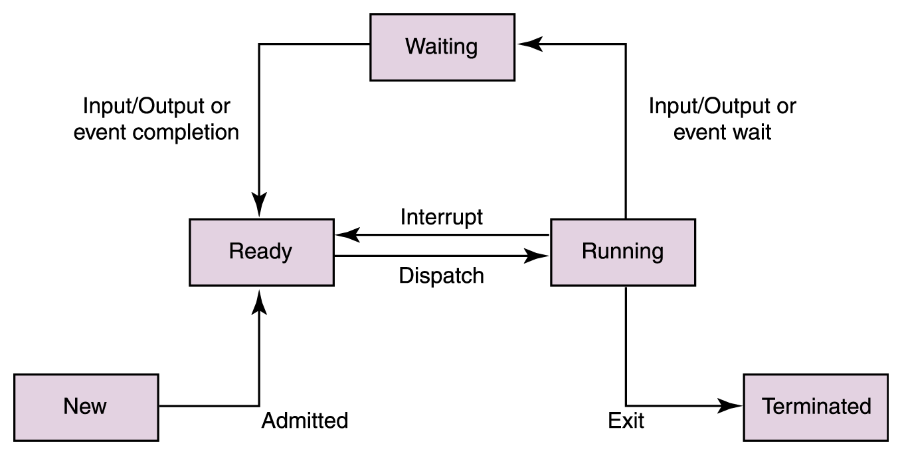




Process States

Slide 12

Process Scheduling
The operating system schedules process execution.
First, the operating system determines which process shall be eventually granted access to the CPU. This is long-term scheduling.
After a number of processes have been admitted, the operating system determines which one will have access to the CPU at any particular moment. This is short-term scheduling.
A context switch occurs when a process is taken from the CPU and replaced by another process.
  Information relating to the state of the process is preserved during a context switch, such as the contents of registers and the page tables
  The state of the other process is restored and resumed
This kind of bookkeeping is time-consuming and burns many CPU cycles

Slide 13
Process Scheduling
Four approaches to CPU scheduling are:
  First-come, first-served: jobs are serviced in arrival sequence and run to completion if they have all of the resources they need.
  Shortest job first: the smallest jobs get scheduled first. (The trouble is in knowing which jobs are shortest!)
  Round robin scheduling: each job is allotted a certain amount of CPU time (called a time quantum). A context switch occurs when the time expires.
  Priority scheduling: preempts a job with a lower priority when a higher-priority job needs the CPU.
Some process scheduling algorithms can cause starvation. This occurs when a process never gets a chance to run because other processes are continually being given preference. Which of the scheduling approaches could cause this?
Notes:
轮转

Slide 14
Quiz 3 Question 1 – Shortest Time First
Process | Arrival Time | Burst Time
P1 | 0 ms | 10 ms
P2 | 3 ms | 2 ms
P3 | 9 ms | 3 ms
P4 | 7 ms | 4 ms
P1: 0ms
P2: 10 – 3 = 7ms
P3: 12 – 9 = 3ms
P4: 15 – 7 = 8ms

Slide 15
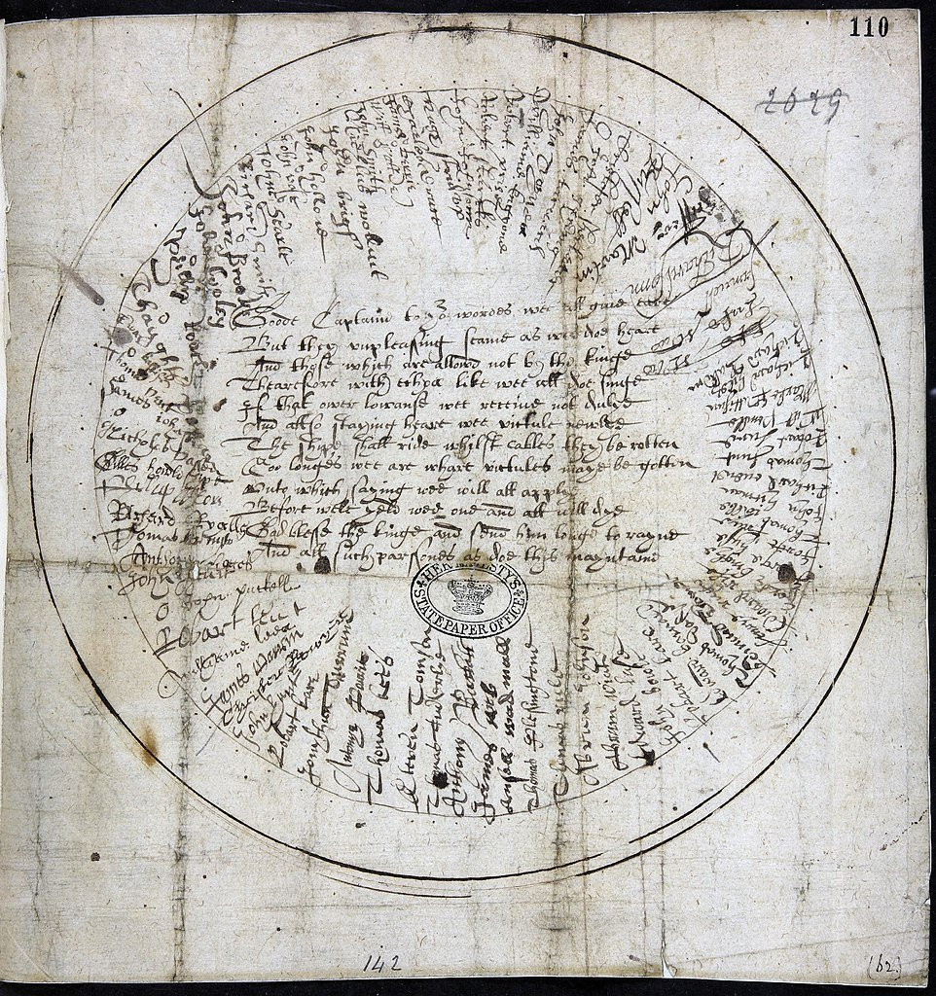
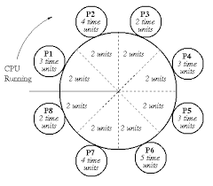
Quiz 3 Question 2 – Round Robin
(the name has nothing to do with the bird)
Process | Burst Time
P1 | 10 ms
P2 | 2 ms
P3 | 3 ms
P4 | 4 ms
P1: 0 + (14 – 5) = 9ms
P2: 5ms
P3: 7ms
P4: 10ms

Slide 16
Resource Management
The OS manages the CPU via the process scheduler
It must also manage the main memory (e.g., virtual memory, paging, segmentation) and I/O devices
The OS must also protect the kernel from interference by user processes
For example, what if multiple processes want to transmit data over the network connection simultaneously? The OS has to mediate these requests and service them in some order.
The OS also manages the filesystem, the methods and structures used by the OS to organize and manage files stored on disk

Slide 17
Protected Environments
In their role as resource managers and protectors, many operating systems provide protected environments that isolate processes, or groups of processes from each other.
Three common approaches to establishing protected environments are virtual machines, subsystems, and partitions.
These environments simplify system management and control, and can provide emulated machines to enable execution of programs that the system would otherwise be unable to run.

Slide 18
Virtual Machines
Virtual machines are a protected environment that presents an image of itself – or the image of a totally different architecture – to the processes that run within the environment.
A virtual machine is exactly that: an imaginary computer.
The underlying real machine is under the control of the kernel. The kernel receives and manages all resource requests that emit from processes running in the virtual environment.
VMs give one way of running untrusted software in a safe environment
The next slide provides an illustration.

Slide 19
Subsystems and Partitions
Subsystems are another type of protected environment.
They provide logically distinct environments that can be individually controlled and managed. They can be started and stopped independently of each other.
Subsystems can have special purposes, such as controlling I/O or virtual machines. Others partition large application systems to make them more manageable.
In many cases, resources must be made visible to the subsystem before they can be accessed by the processes running within it.
The next slide provides an illustration.

Slide 20
Partitions
In very large computers, subsystems do not go far enough to establish a protected environment.
Logical partitions (LPARs) provide much higher barriers: Processes running within a logical partition have no access to processes running in another partition unless a connection between them is explicitly established.
LPARs are an enabling technology for the recent trend of consolidating hundreds of small servers within the confines of a single large system.
The next slide provides an illustration.

Slide 21
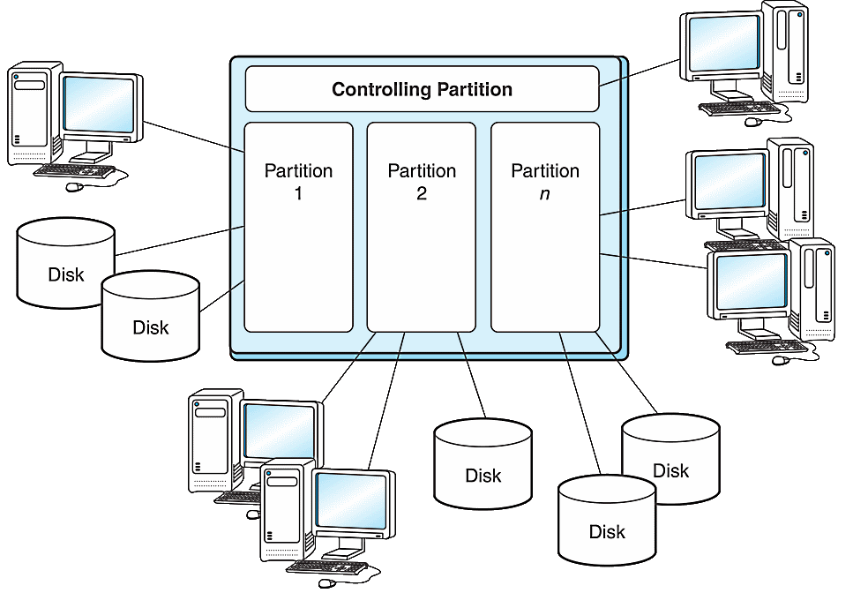
Logical Partitions Example

Slide 22
Logical Partitions
LPARs are good for creating “sandbox” environments
On one powerful server (or set of machines) we might have a copy of the released version of some software produced by a company
  This version would run in its own partition
On the same server we might have a “development” version that programmers are using to work on the next version of the software
The two copies of the software can run and exist on the same computer(s) without interference from each other

Slide 23
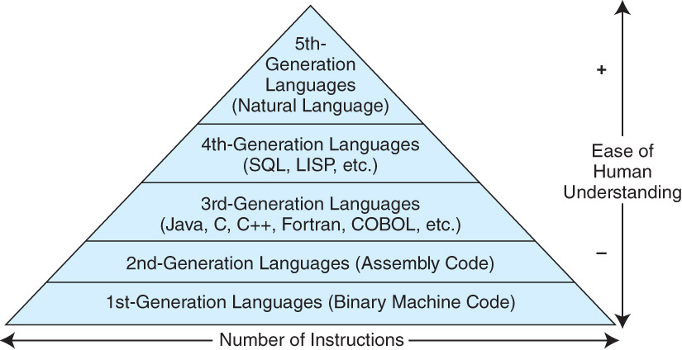
Programming Tools

Slide 24
Programming Tools
Programming tools carry out the mechanics of software creation within the confines of the operating system and hardware environment.
Assemblers are the simplest of all programming tools. They translate mnemonic instructions to machine code.
Assembly language is considered a “second generation” programming language (2GL).
High-level programming languages, such as C, C++, Pascal, and COBOL, are “third generation” languages (3GLs).
Each language generation presents problem solving tools that are closer to how people think and farther away from how the machine implements the solution.

Slide 25
Programming Tools
Compilers bridge the semantic gap between the higher level language and the machine’s binary instructions.
A compiler takes the source code for a program as input and then outputs machine code for the target platform
This is a multi-step process that first analyzes the code for its structure and, assuming the code is syntactically correct, generates the machine code
Modern compilers also attempt to optimize the code so that the compiled program runs as fast as possible
Popular compiled languages include C, C++, Java

Slide 26
Programming Tools
Interpreters produce executable code from source code in real time, one line at a time.
Consequently, this not only makes interpreted languages slower than compiled languages but it also affords less opportunity for error checking.
Interpreted languages are, however, very useful for teaching programming concepts, because feedback is nearly instantaneous, and performance is rarely a concern.
Also, in software development, interpreted languages are very useful when the underlying code needs to be changed frequently
Popular interpreted languages include JavaScript (for the web), Python, Ruby, Java
Wait…I thought Java was compiled?

Slide 27
Java: All Most of the Above
The Java programming language exemplifies many of the concepts that we have discussed so far in this Unit
Java programs execute within a virtual machine, the Java Virtual Machine (JVM).
This allows the language to run on any platform for which a virtual machine environment has been written. (“Write once, run anywhere.”)
Java is both a compiled and an interpreted language. The output of the compilation process is an assembly-like intermediate code (bytecode) that is interpreted by the JVM.
The JVM is an operating system in miniature. It runs programs, manages program resources, and deallocates resources when the programs terminate.

Slide 28
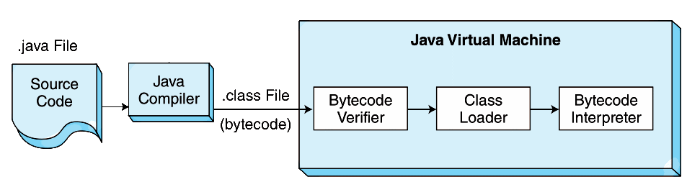
Java: All Most of the Above
Because the JVM performs many tasks at run time, its performance cannot match the performance of a traditional compiled language.

Slide 29
Unit 08 Network Organization and Architecture
OSI and TCP/IP Model, IPv4, TCP/IP Transmission
Repeater -> Hub -> Switch -> Bridge -> Gateway -> Router

Slide 30
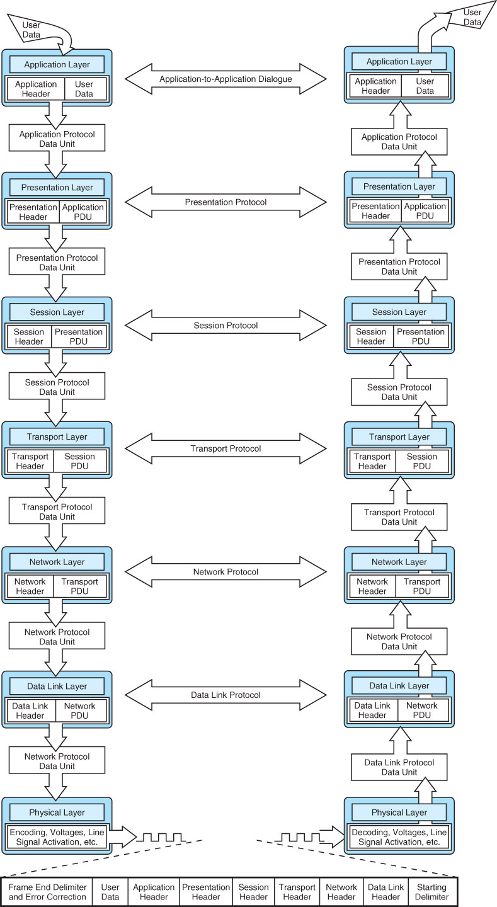
ISO/OSI Reference Model (top 4 layers)

Slide 31
ISO/OSI Reference Model (bottom 3 layers)

Slide 32

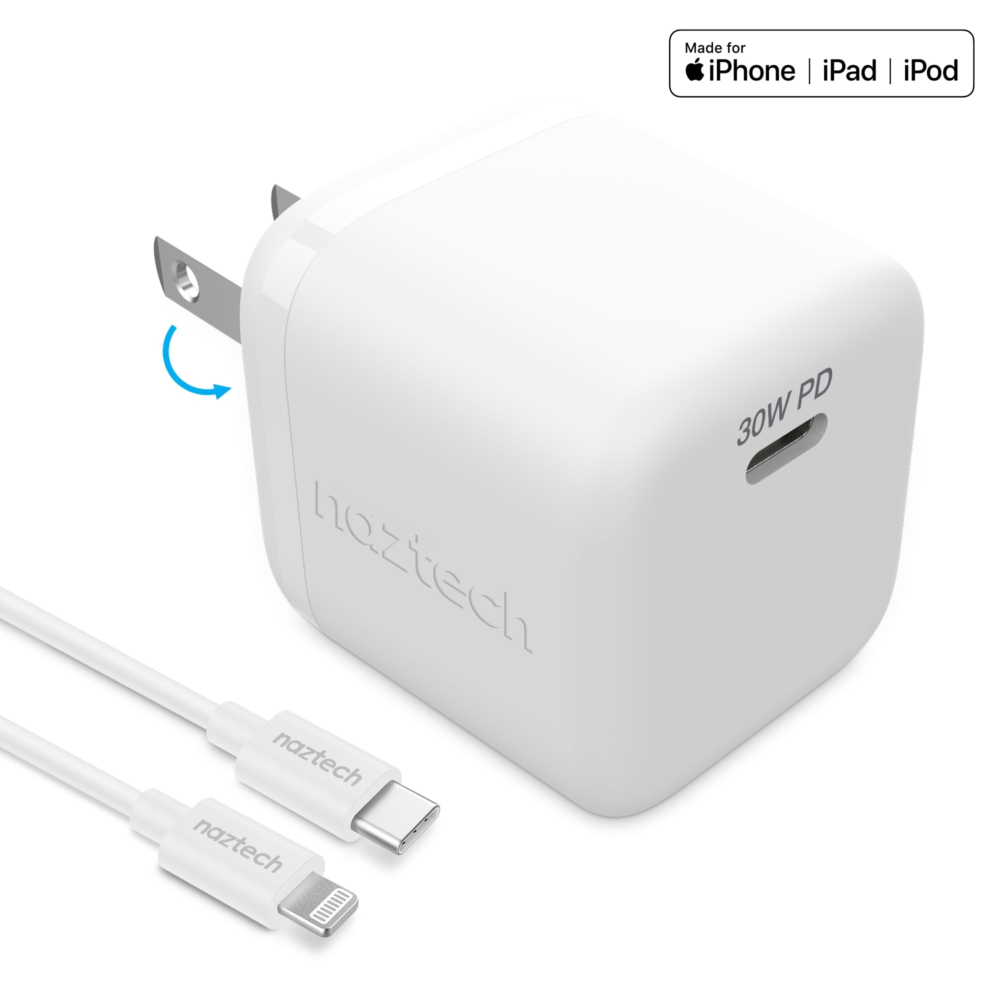
PDNTSPA mnemonic
Please Do Not Throw Sausage Pizza Away
Notes:
Nei-monic

Slide 33
ISO/OSI Reference Model
The basic unit of data in the OSI model is the protocol data unit (PDU)
Each layer communicates to the next through a clearly defined service access point (SAP)
Each layer adds its own data to the PDU before passing it up to the next higher layer
Likewise, as a PDU travels down the protocol stack, each layer strips off its layer-dependent data and passes the now-smaller PDU down to the next layer

Slide 34
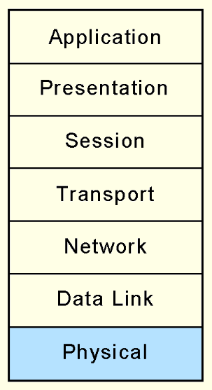
ISO/OSI Model: Physical Layer
The Physical layer receives a stream of bits from the Data Link layer above it, encodes them, and places them on the communications medium.
The Physical layer conveys transmission frames, called Physical Protocol Data Units, or Physical PDUs.
Each physical PDU carries an address and has delimiter signal patterns that surround the payload, or contents, of the PDU.
Examples of physical transmission media could include wireless, copper, satellite and optical fiber
This layer is concerned primarily with the transmission of raw bits over the communication medium

Slide 35
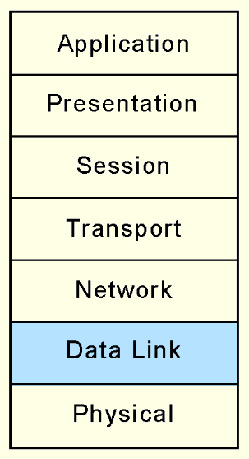
ISO/OSI Model: Data Link Layer
The Data Link layer negotiates frame sizes and the speed at which they are sent with the Data Link layer at the other end.
The timing of frame transmission is called flow control.
Data Link layers at both ends acknowledge packets as they are exchanged. The sender retransmits the packet if no acknowledgement is received within a given time interval.

Slide 36
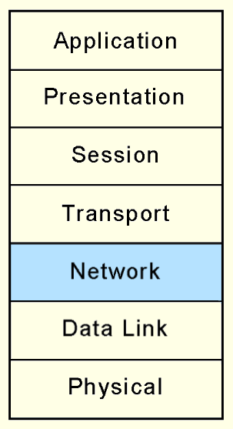
ISO/OSI Model: Network Layer
At the originating computers, the Network layer adds addressing information to the Transport layer PDUs.
The Network layer establishes the route and ensures that the PDU size is compatible with all of the equipment between the source and the destination.
Its most important job is in moving (routing) PDUs across intermediate nodes.

Slide 37
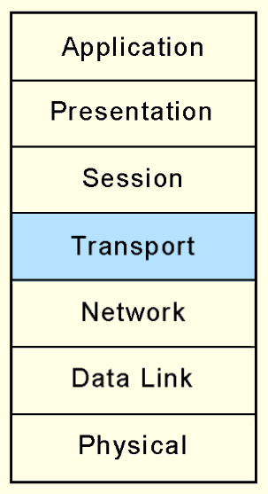
ISO/OSI Model: Transport Layer
The OSI Transport layer provides end-to-end acknowledgement and error correction through its handshaking with the Transport layer at the other end of the conversation.
The Transport layer is the lowest layer of the OSI model at which there is any awareness of the network or its protocols.
The Transport layer assures the Session layer that there are no network-induced errors in the PDU.
The Transport layer must break the messages into smaller units (frames), prepending a header to each frame to form the Transport layer PDU

Slide 38
ISO/OSI Model: Transport Layer
The Session layer above the Transport layer can thereby (1) send/receive large messages of whatever size it wants and (2) do so without worry about data loss
  The Transport layer handles both issues

Slide 39
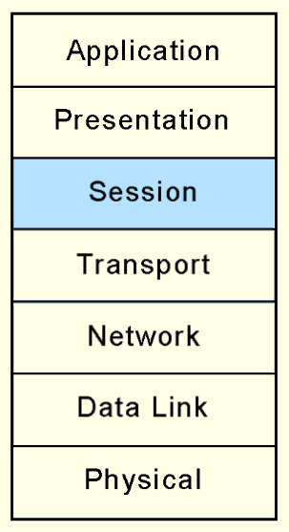
ISO/OSI Model: Session Layer
The Session layer arbitrates the dialogue between two communicating nodes, opening and closing that dialogue as necessary.
It controls the direction and mode (half-duplex or full-duplex).
Half-duplex: communication travels only in one direction
Full-duplex: communication travels in both directions
It also supplies recovery checkpoints during file transfers.
Checkpoints are issued each time a block of data is acknowledged as being received in good condition.
In this way, if the connection is completely lost, it can be resumed

Slide 40
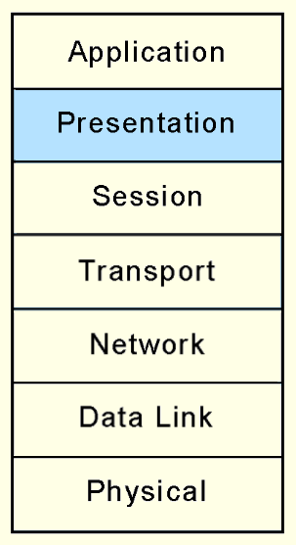
ISO/OSI Model: Presentation Layer
The Presentation layer provides high-level data interpretation services for the Application layer above it, such as EBCDIC-to-ASCII translation.
Presentation layer services are also called into play if we use encryption or certain types of data compression.

Slide 41
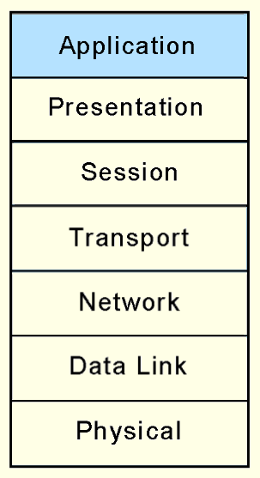
ISO/OSI Model: Application Layer
The Application layer supplies meaningful information and services to users at one end of the communication and interfaces with system resources (programs and data files) at the other end of the communication.
All that applications need to do is to send messages to the Presentation layer, and the lower layers take care of the hard part.

Slide 42
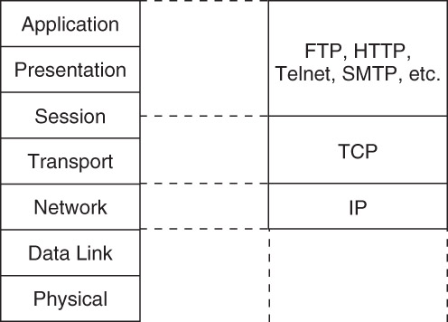
TCP/IP Network Architecture
TCP/IP is the de facto global data communications standard.
It has a lean 3-layer protocol stack that can be mapped to five of the seven in the OSI model.
TCP/IP can be used with any type of network, even different types of networks within a single session.

Slide 43
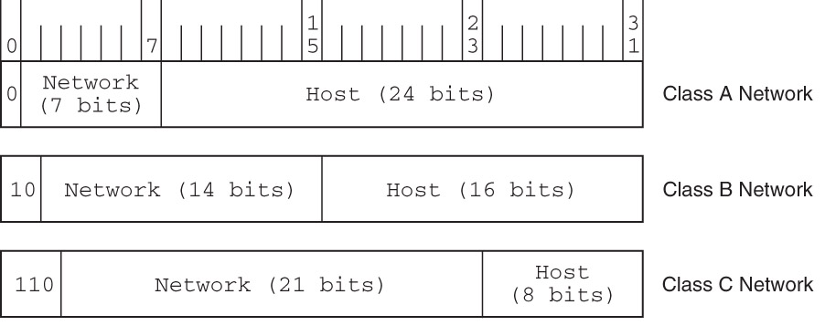
IPv4 Address Space
The IPv4 Address Space is divided into five different classes (only three shown here)
A network’s class determines the maximum number computers that could be on that network

Slide 44
IPv4 Address Space
What is the maximum number of hosts that can be defined in a class A network?
Answer: 2²⁴

Slide 45
IPv4 Address Space
A computer has the IP address 221.15.220.192
What network class does it belong to?
Answer: 221₁₀ = 11011101₂, so class C

Slide 46
TCP Windows: Example #1
Two stations running TCP/IP are engaged in transferring a file. This file is 100K long, the payload size is 100 bytes, and the negotiated congestion window size is 300 bytes. The sender receives an ACK 1500 from the receiver.
Which bytes will be sent next?
Answer: bytes 1500 through 1599

Slide 47
TCP Windows: Example #2
Two stations running TCP/IP are engaged in transferring a file. This file is 100KB long, the payload size is 100 bytes, and the negotiated congestion window size is 300 bytes. The sender receives an ACK 1500 from the receiver.
What is the last byte number that can be sent without an ACK being sent by the receiver?
Answer: byte 1799

Slide 48
TCP Congestion Control
The TCP window size can be adjusted dynamically, over time (during exchange of messages) to help with congestion control
  If the sender is transmitting data faster than the receiver can process it, packets will be dropped (lost)
  The congestion window size can then be decreased so that fewer bytes are sent at a time
TCP uses the congestion control scheme known as additive-increase/multiplicative-decrease (AIMD)
The idea is simple, yet effective: if no packets are lost during one round-trip between the sender and receiver, the window size can be increased by some small, fixed amount (“additive increase”)
But if packets are lost, the window size can be reduced by a large fraction, such as one-half (“multiplicative decrease”)

Slide 49
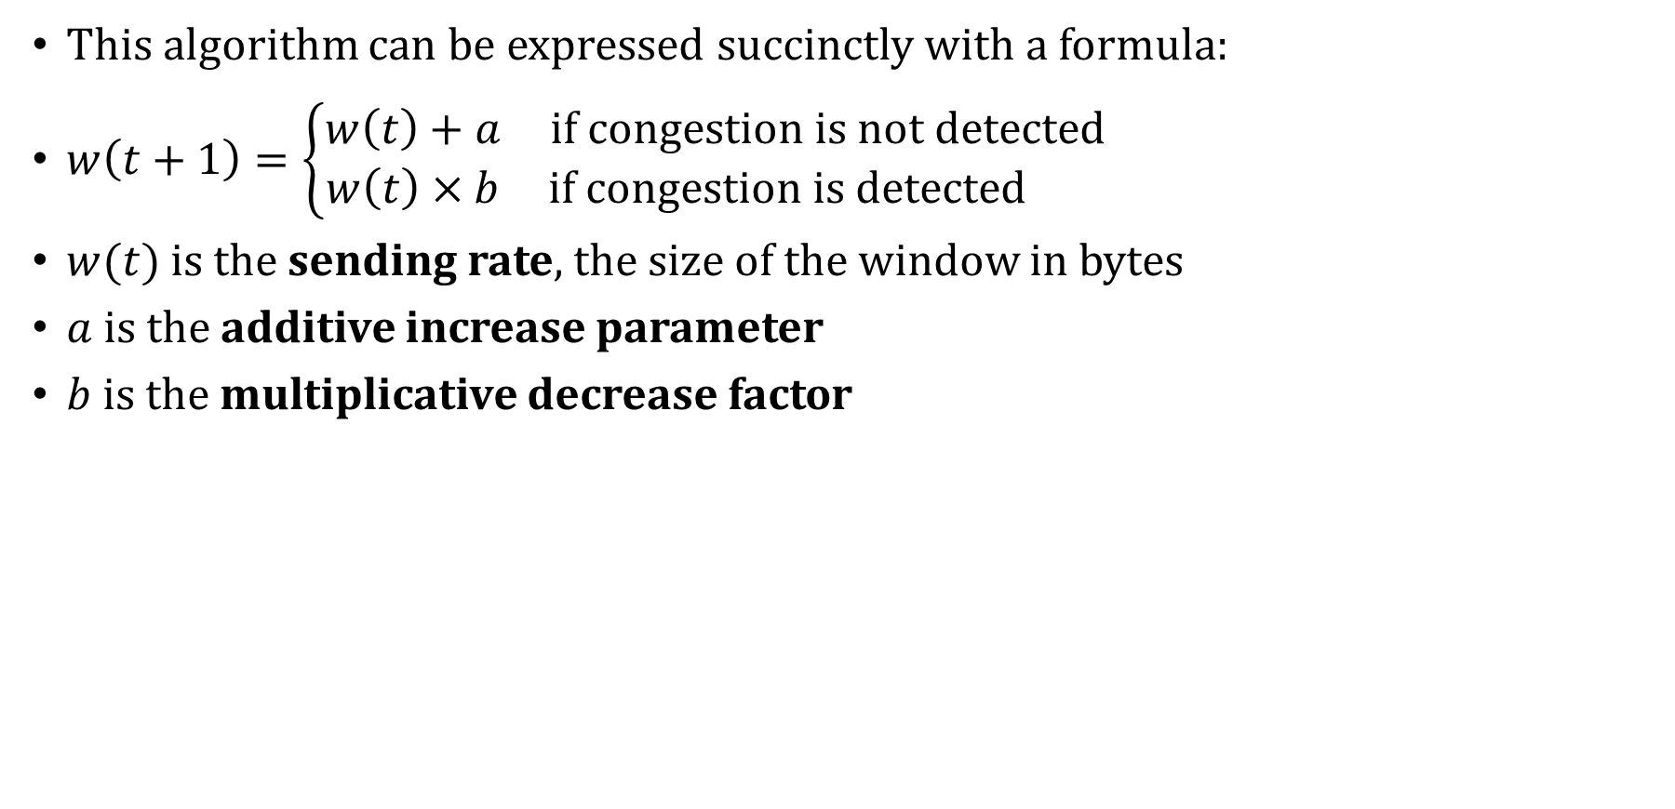
TCP Congestion Control
This algorithm can be expressed succinctly with a formula:
$w\left(t+1\right)=\left\{\begin{matrix}w\left(t\right)+a & if congestion is not detected \\ w\left(t\right)×b & if congestion is detected \end{matrix}\right.$
$w(t)$ is the sending rate, the size of the window in bytes
$a$ is the additive increase parameter
$b$ is the multiplicative decrease factor

Slide 50
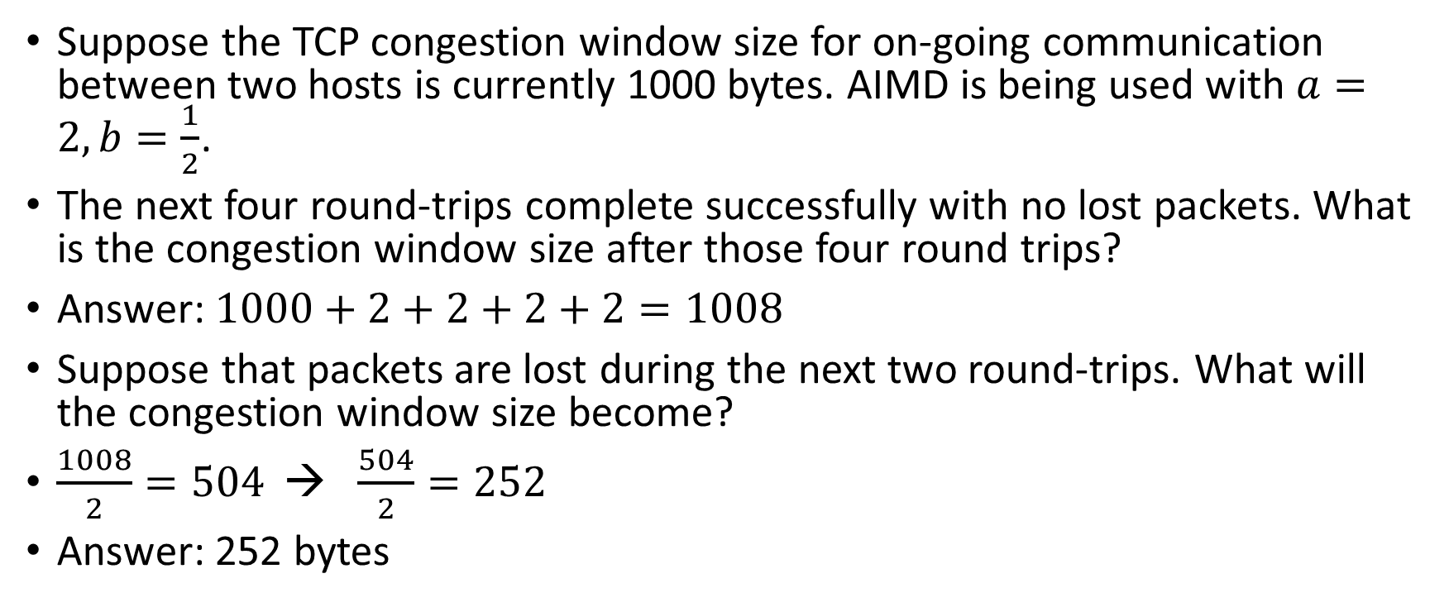
TCP Congestion Control: Example
Suppose the TCP congestion window size for on-going communication between two hosts is currently 1000 bytes. AIMD is being used with $a=2, b=\frac{1}{2}$.
The next four round-trips complete successfully with no lost packets. What is the congestion window size after those four round trips?
Answer: $1000+2+2+2+2=1008$
Suppose that packets are lost during the next two round-trips. What will the congestion window size become?
$\frac{1008}{2}=504$ → $\frac{504}{2}=252$
Answer: 252 bytes

Slide 51
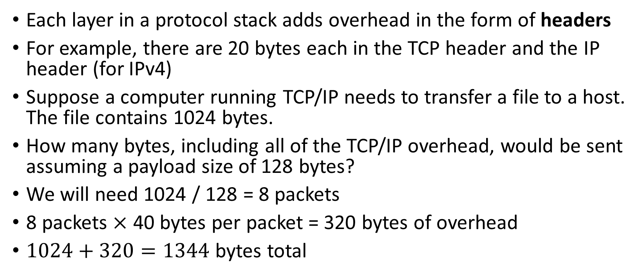
Protocol Overhead: Example
Each layer in a protocol stack adds overhead in the form of headers
For example, there are 20 bytes each in the TCP header and the IP header (for IPv4)
Suppose a computer running TCP/IP needs to transfer a file to a host. The file contains 1024 bytes.
How many bytes, including all of the TCP/IP overhead, would be sent assuming a payload size of 128 bytes?
We will need 1024 / 128 = 8 packets
8 packets $×$ 40 bytes per packet = 320 bytes of overhead
$1024+320=1344$ bytes total

Slide 52
Unit 09 Performance Measurement and Analysis
Benchmarking, Disk Scheduling

Slide 53
Benchmarking
Performance benchmarking is the science of making objective assessments concerning the performance of one system over another.
Price-performance ratios can be derived from standard benchmarks.
The troublesome issue is that there is no definitive benchmark that can tell you which system will run your applications the fastest (using the least wall clock time) for the least amount of money.
In reality, there is no single system metric we can use

Slide 54
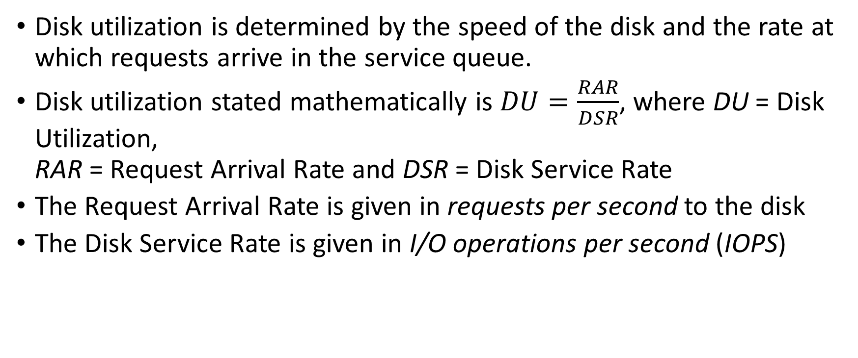
Disk Performance
Disk utilization is determined by the speed of the disk and the rate at which requests arrive in the service queue.
Disk utilization stated mathematically is $DU=\frac{RAR}{DSR}$, where DU = Disk Utilization,
RAR = Request Arrival Rate and DSR = Disk Service Rate
The Request Arrival Rate is given in requests per second to the disk
The Disk Service Rate is given in I/O operations per second (IOPS)

Slide 55
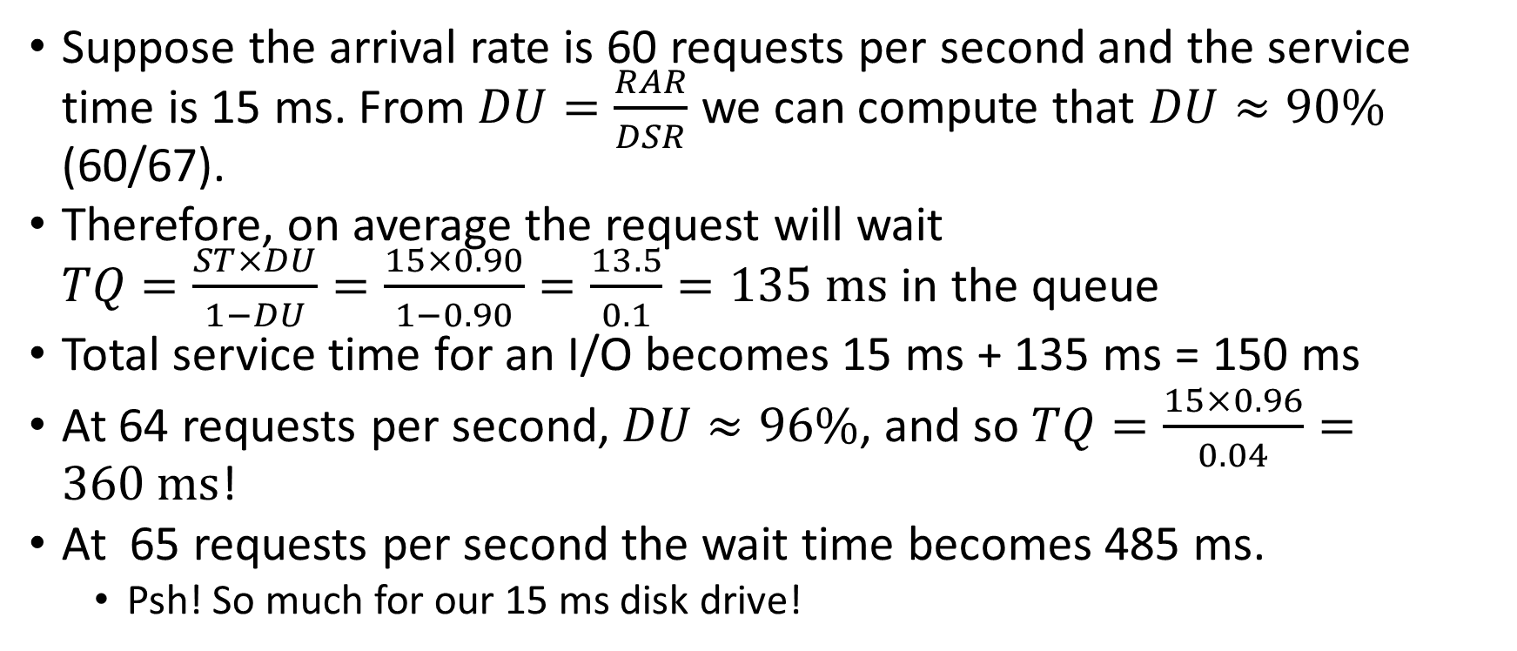
Disk Performance: Example #2
Suppose the arrival rate is 60 requests per second and the service time is 15 ms. From $DU=\frac{RAR}{DSR}$ we can compute that $DU≈90\%$ (60/67).
Therefore, on average the request will wait
$TQ=\frac{ST×DU}{1−DU}=\frac{15×0.90}{1−0.90}=\frac{13.5}{0.1}=135 ms$ in the queue
Total service time for an I/O becomes 15 ms + 135 ms = 150 ms
At 64 requests per second, $DU≈96\%$, and so $TQ=\frac{15×0.96}{0.04}=360 ms$!
At 65 requests per second the wait time becomes 485 ms.
  Psh! So much for our 15 ms disk drive!

Slide 56
Disk Performance
The manner in which files are organized on a disk greatly affects throughput.
Disk arm motion is the greatest consumer of service time.
Disk specifications cite average seek time, which is usually in the range of 5 to 10 ms.
However, a full-stroke seek (moving the disk arm from the innermost track to the outermost, or vice versa) can take as long as 15 to 20 ms.
Clever disk scheduling algorithms endeavor to minimize seek time.

Slide 57
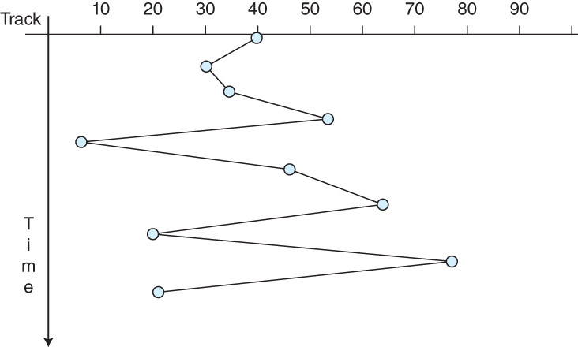
Disk Scheduling: FCFS
The most naïve disk scheduling policy is first-come, first-served (FCFS).
As its name implies, FCFS services all I/O requests in the order in which they arrive in the queue.
With this approach, there
is no real control over arm
motion, so random, wide
sweeps across the disk are
possible (see figure).
Using FCFS, performance is
unpredictable and widely
variable.

Slide 58
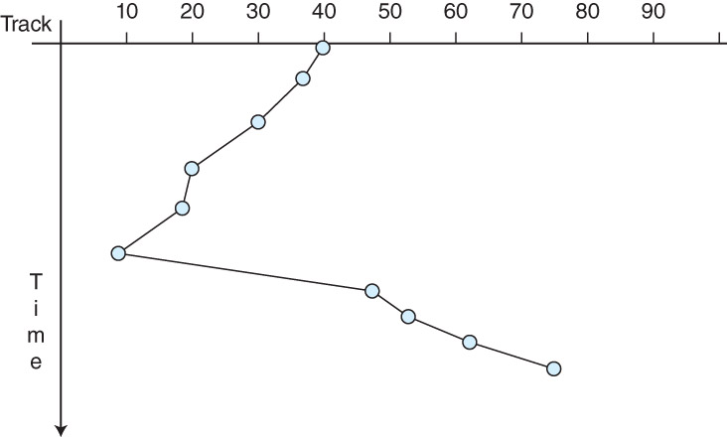
Disk Scheduling: SSTF
Arm motion is reduced when requests are ordered so that the disk arm moves only to the track nearest its current location.
This is the idea employed by the shortest seek time first (SSTF) scheduling algorithm.
Disk track requests are
queued and selected so that
the minimum arm motion is
involved in servicing the
request (see figure).

Slide 59
Disk Scheduling: SSTF
With SSTF, starvation is possible: A track request for a “remote” track could keep getting shoved to the back of the queue nearer requests are serviced.
To avoid starvation, fairness can be enforced by having the disk arm continually sweep over the surface of the disk, stopping when it reaches a track for which it has a request.
  This approach is called an elevator algorithm.

Slide 60
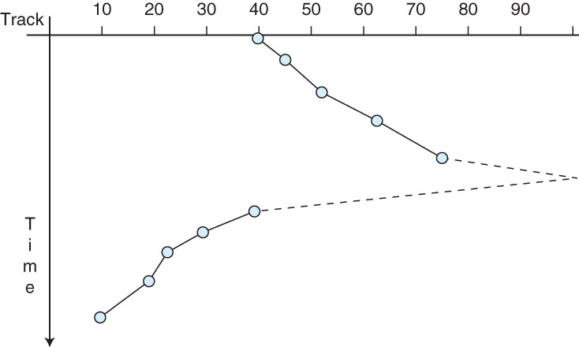
Disk Scheduling: SCAN
In the context of disk scheduling, the elevator algorithm is known as SCAN (which is not an acronym).
While SCAN entails a lot of arm motion, the motion is constant and predictable.
Moreover, the arm changes
direction only twice: at the
center and at the outermost
edges of the disk (see figure).

Slide 61
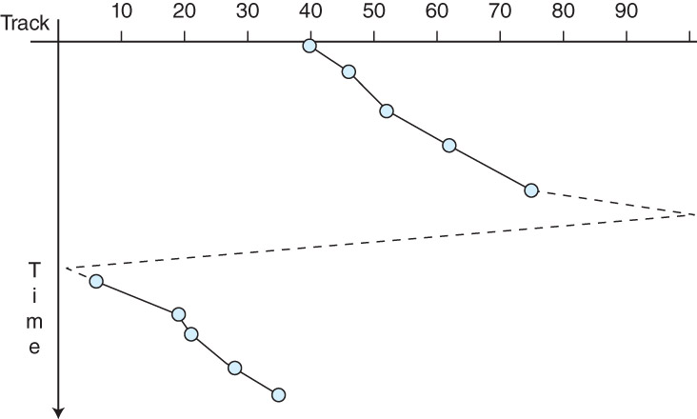
Disk Scheduling: C-SCAN
A SCAN variant, called C-SCAN for circular SCAN, treats track zero as if it is adjacent to the highest-numbered track on the disk.
The arm moves in one direction only, providing a simpler SCAN implementation.
The figure on the right
illustrates a series of read
requests where after track 75
is read, the arm passes to track
99, and then to track 0, from
which it starts reading the
lowest-numbered tracks,
starting with track 6.

Slide 62
Disk Scheduling: C-SCAN
The motivation for C-SCAN might not be clear
Consider the arm’s movement in regular SCAN as it “turns around” and heads back in the other direction
It is likely to not be processing many I/O requests initially because it just passed over those tracks
Also, the tracks at the opposite edge of the platter now have a long wait to be serviced
C-SCAN solves both of these problems and reduces the amount of variance in how long it takes for the disk to service I/O requests

Slide 63
Disk Scheduling: LOOK
The disk arm motion of SCAN and C-SCAN can be reduced through the use of the LOOK and C-LOOK algorithms.
Instead of sweeping the entire disk, the disk arm travels only to the highest- and lowest-numbered tracks for which access requests are pending.
Although the circuitry is more complex, LOOK and C-LOOK provide the best theoretical throughput, although the circuitry is the most complex.

Slide 64
Disk Scheduling: Example #1
In what order would the hard disk tracks 23, 95, 44, 42, 76, 71, 55 be visited using the FCFS algorithm? Assume each platter of the disk has 100 tracks numbered 0 through 99. At the time the first request arrives in the disk request queue, the read/write head is at track 50, moving toward higher-numbered tracks.
Answer: 23, 95, 44, 42, 76, 71, 55

Slide 65
Disk Scheduling: Example #2
In what order would the hard disk tracks 23, 95, 44, 42, 76, 71, 55 be visited using the SSTF algorithm? Assume each platter of the disk has 100 tracks numbered 0 through 99. At the time the first request arrives in the disk request queue, the read/write head is at track 50, moving toward higher-numbered tracks.
Answer: 55, 44, 42, 23, 71, 76, 95

Slide 66
Disk Scheduling: Example #3
In what order would the hard disk tracks 23, 95, 44, 42, 76, 71, 55 be visited using the SCAN algorithm? Assume each platter of the disk has 100 tracks numbered 0 through 99. At the time the first request arrives in the disk request queue, the read/write head is at track 50, moving toward higher-numbered tracks. Indicate when the head arrives at track 0 and/or track 99.
Answer: 55, 71, 76, 95, (99), 44, 42, 23

Slide 67
Disk Scheduling: Example #4
In what order would the hard disk tracks 23, 95, 44, 42, 76, 71, 55 be visited using the C-SCAN algorithm? Assume each platter of the disk has 100 tracks numbered 0 through 99. At the time the first request arrives in the disk request queue, the read/write head is at track 50, moving toward higher-numbered tracks. Indicate when the head arrives at track 0 and/or track 99.
Answer: 55, 71, 76, 95, (99), (0), 23, 42, 44

Slide 68
Disk Scheduling: Example #5
In what order would the hard disk tracks 23, 95, 44, 42, 76, 71, 55 be visited using the LOOK algorithm? Assume each platter of the disk has 100 tracks numbered 0 through 99. At the time the first request arrives in the disk request queue, the read/write head is at track 50, moving toward higher-numbered tracks.
Answer: 55, 71, 76, 95, 44, 42, 23

Slide 69
Disk Scheduling: Example #6
In what order would the hard disk tracks 23, 95, 44, 42, 76, 71, 55 be visited using the C-LOOK algorithm? Assume each platter of the disk has 100 tracks numbered 0 through 99. At the time the first request arrives in the disk request queue, the read/write head is at track 50, moving toward higher-numbered tracks.
Answer: 55, 71, 76, 95, 23, 42, 44

